Slide 1

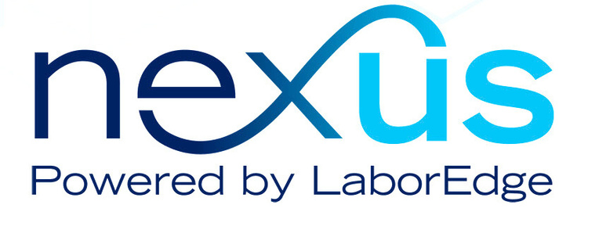
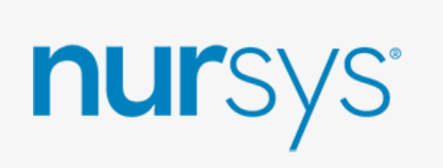
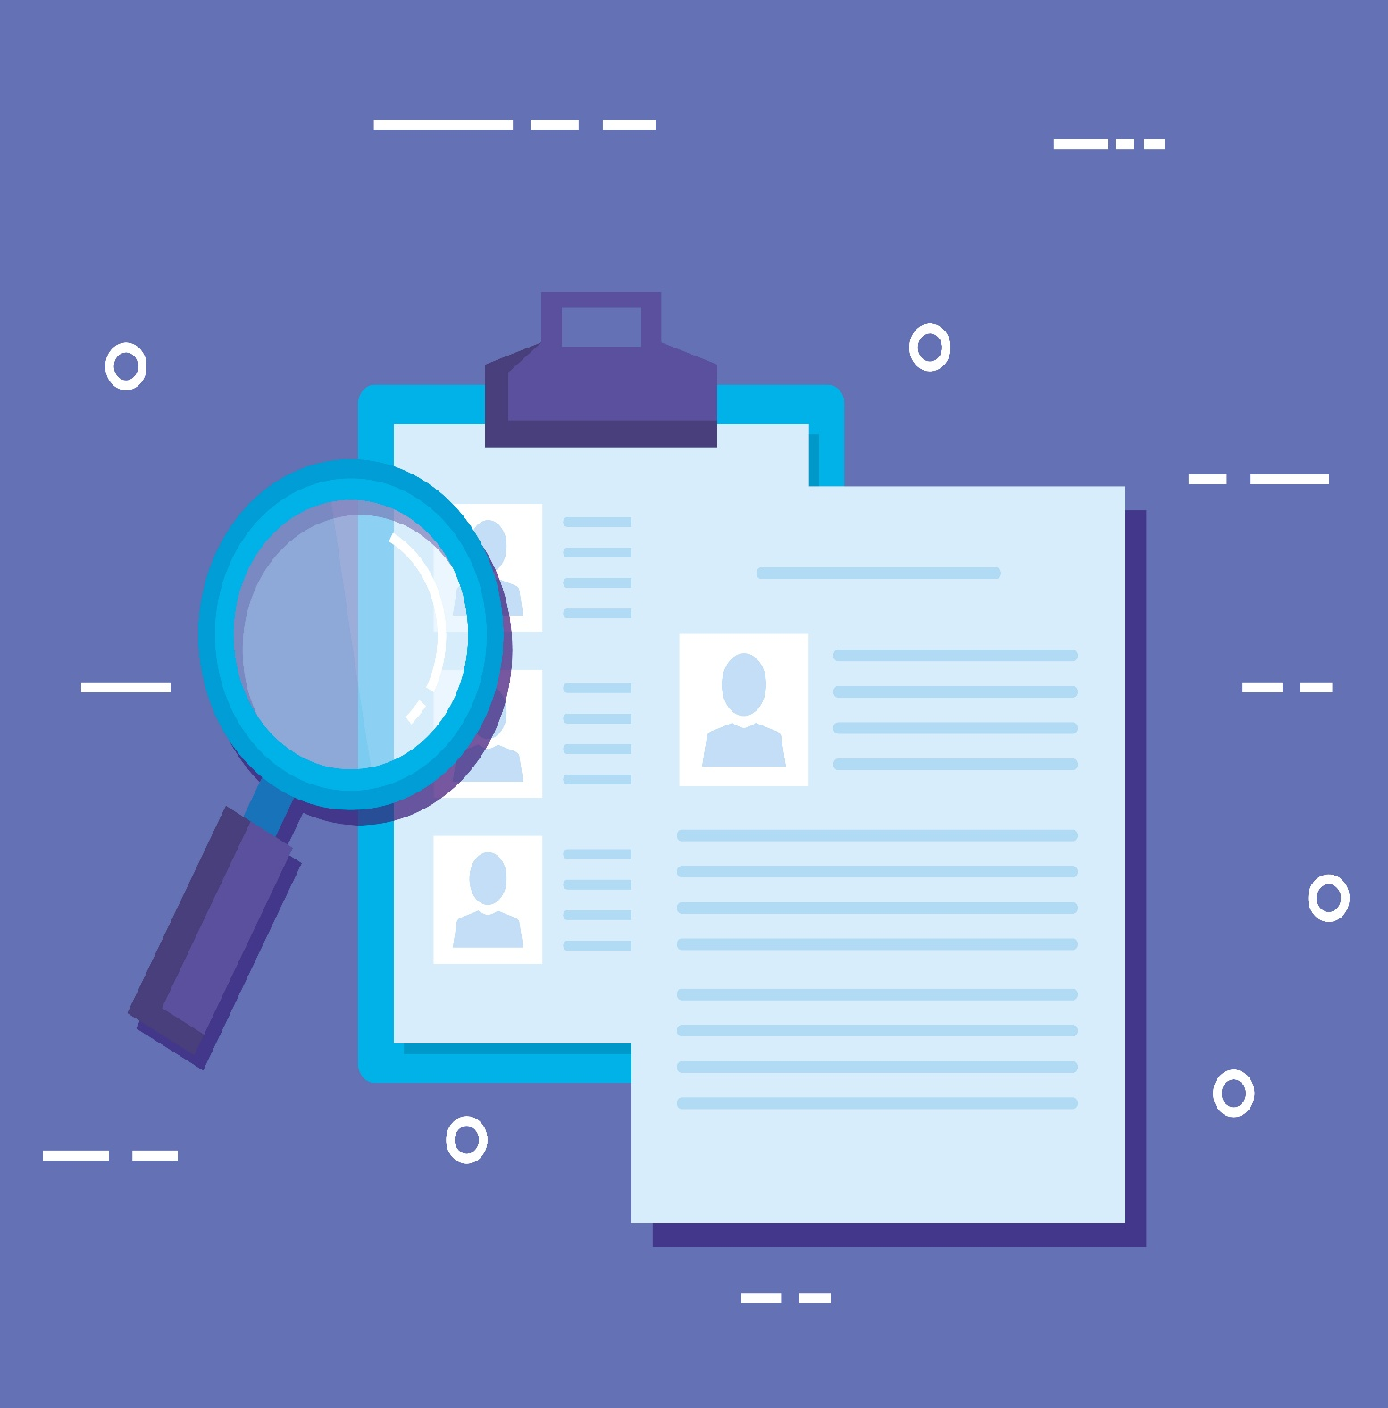
Notes:
Voiceover: Nursys meets NexusATS – Your effortless nurse licensure verification starts here.

Slide 2
Notes:
Voiceover: Nursys is the sole national database for nurse licensure, discipline, and practice privileges.
Nursys data is secure, current, and reviewed by the State Boards of Nursing.

Slide 3
Notes:
Voiceover: NexusATS connects with Nursys to auto-pull the verified licensure data directly into your workflow.
The Nursys integration powers real-time compliance checks and alerts for expiring credentials.

Slide 4
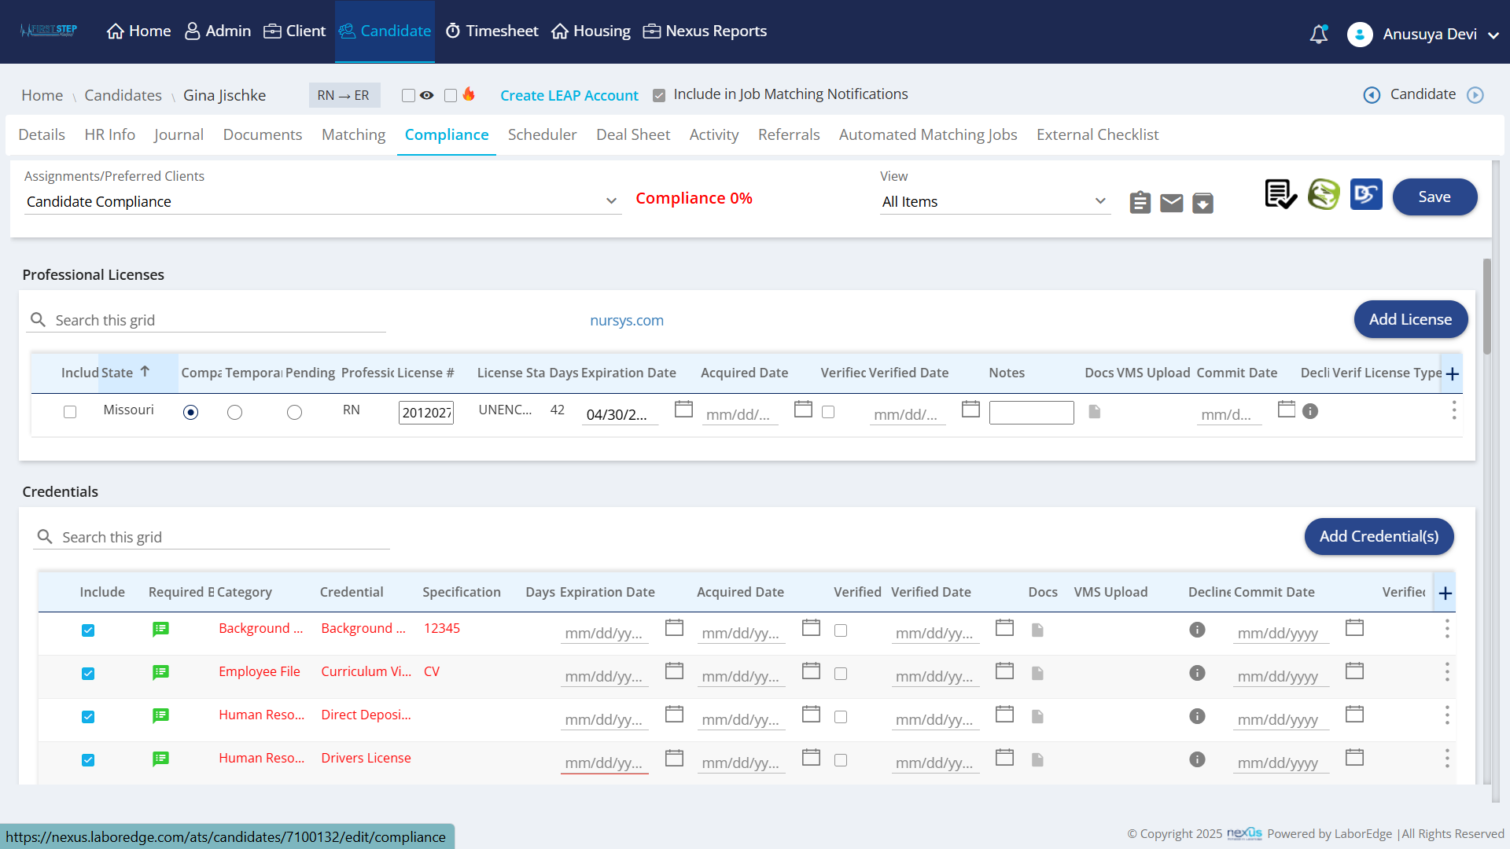
Notes:
Voiceover: Nursys is integrated into each candidate’s compliance section in NexusATS.

Slide 5
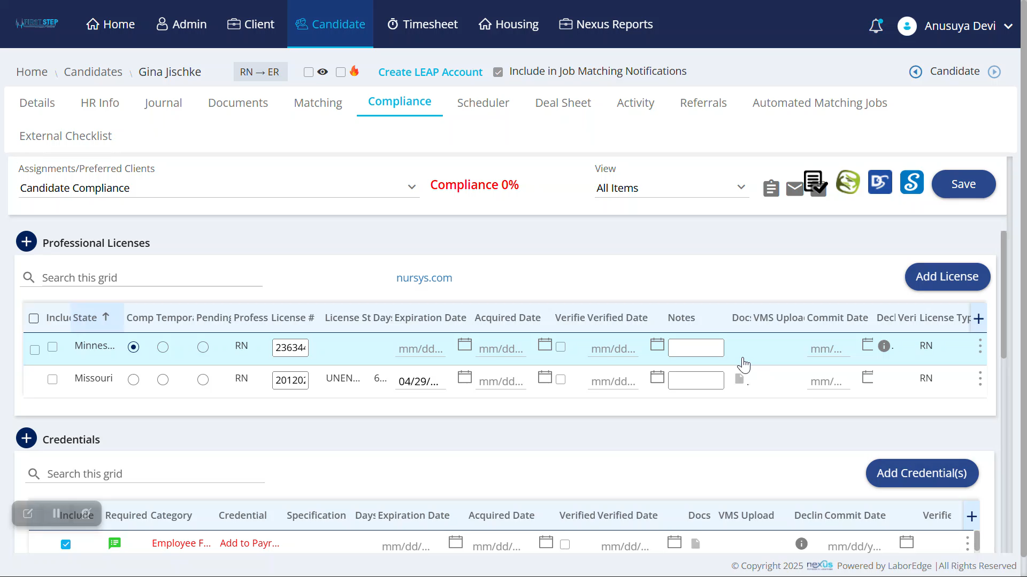
Notes:
Voiceover: Compliance details manually entered by recruiters and candidates are often unverified—but with Nursys, they can be instantly validated within NexusATS.
In case of a data mismatch, Nursys flags it by pulling the correct one—ensuring no more credibility issues.

Slide 6
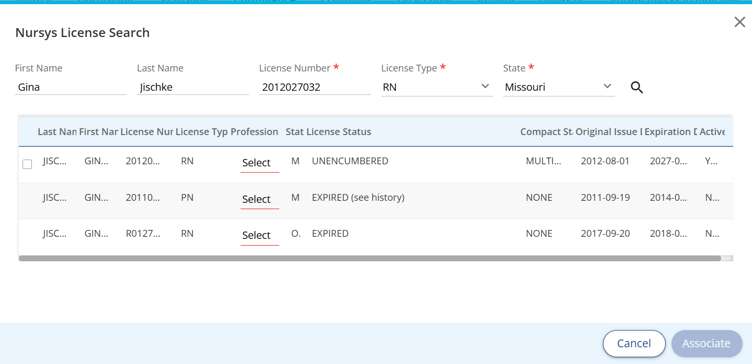

***
Notes:
Voiceover: The extended validation details offer deeper compliance insights—like encumbrance, expiration, and active status—ensuring confident compliance every time.

Slide 7
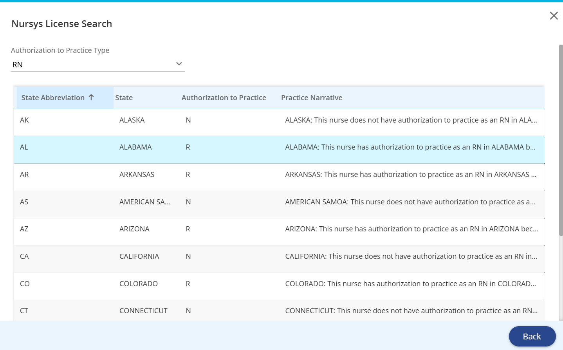
Notes:
Voiceover: Nursys also expands a candidate’s work range by clearly displaying detailed multi-state license eligibility.

Slide 8
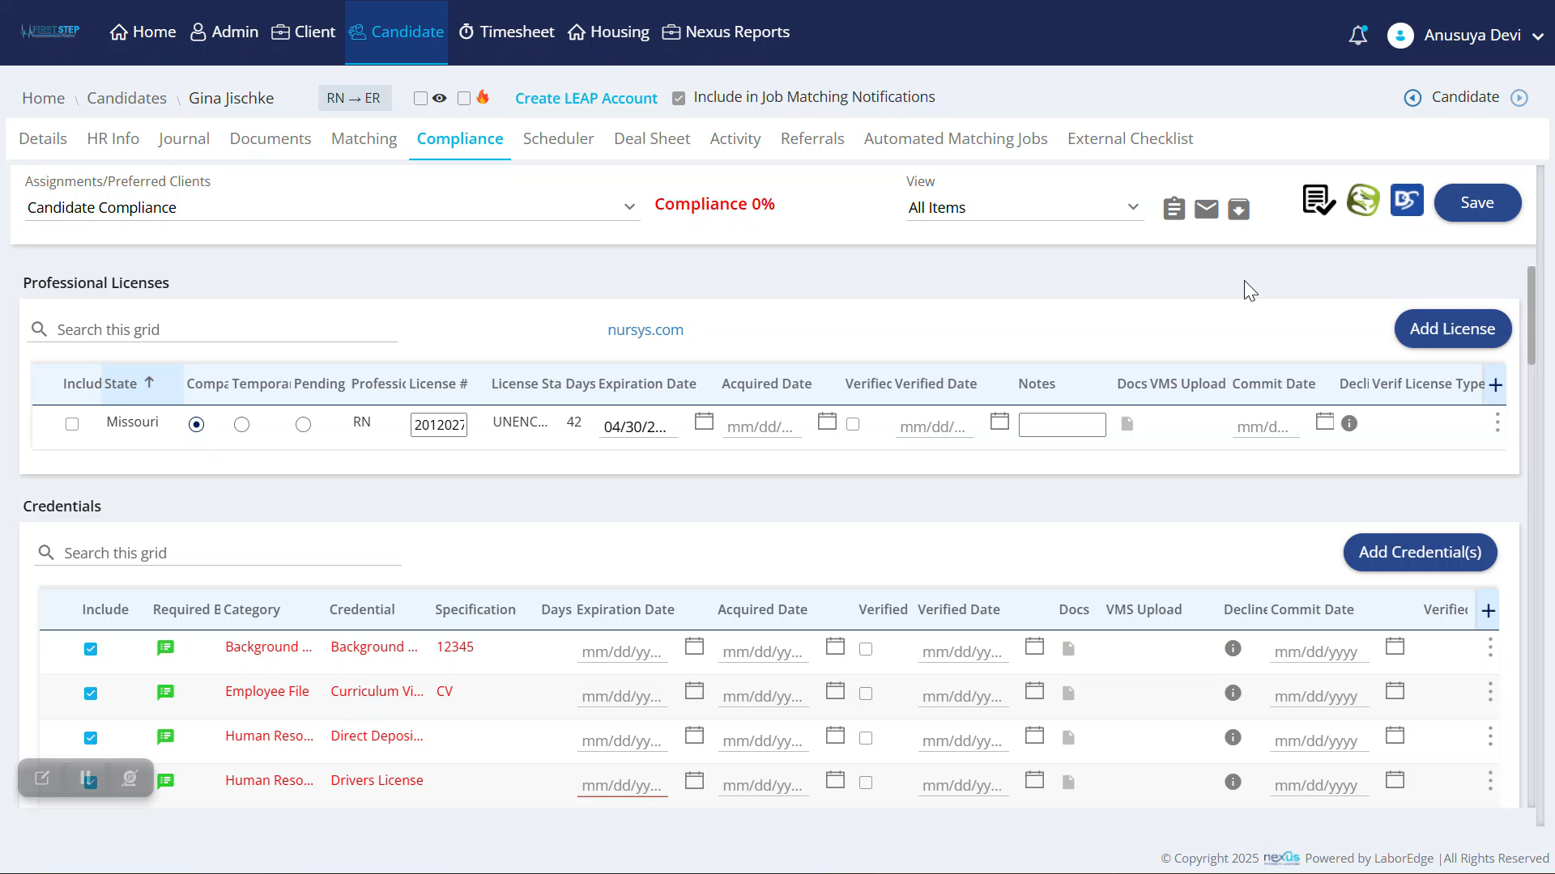
Notes:
Voiceover: Using this integration is easy—just click the Nursys logo, enter the mandatory license details to verify or fetch them from the database.

Slide 9
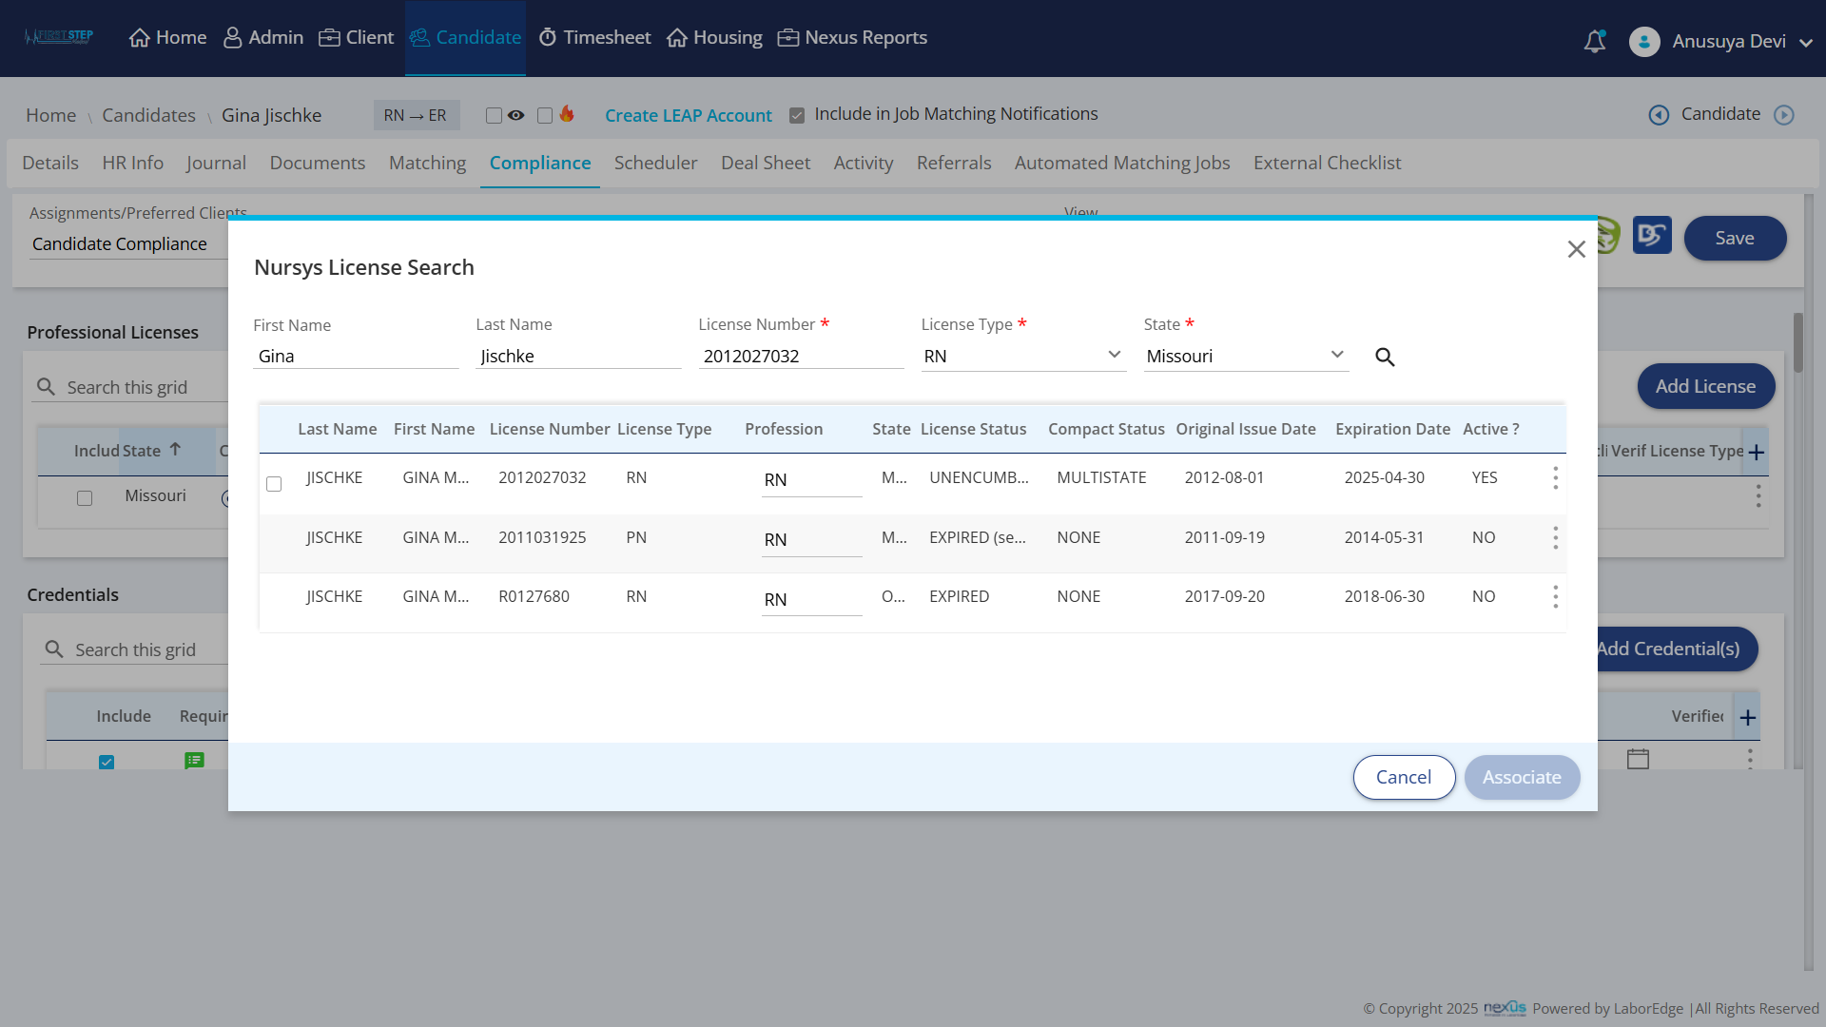
***
Notes:
Voiceover: The search results display complete license details available from Nursys.

Slide 10
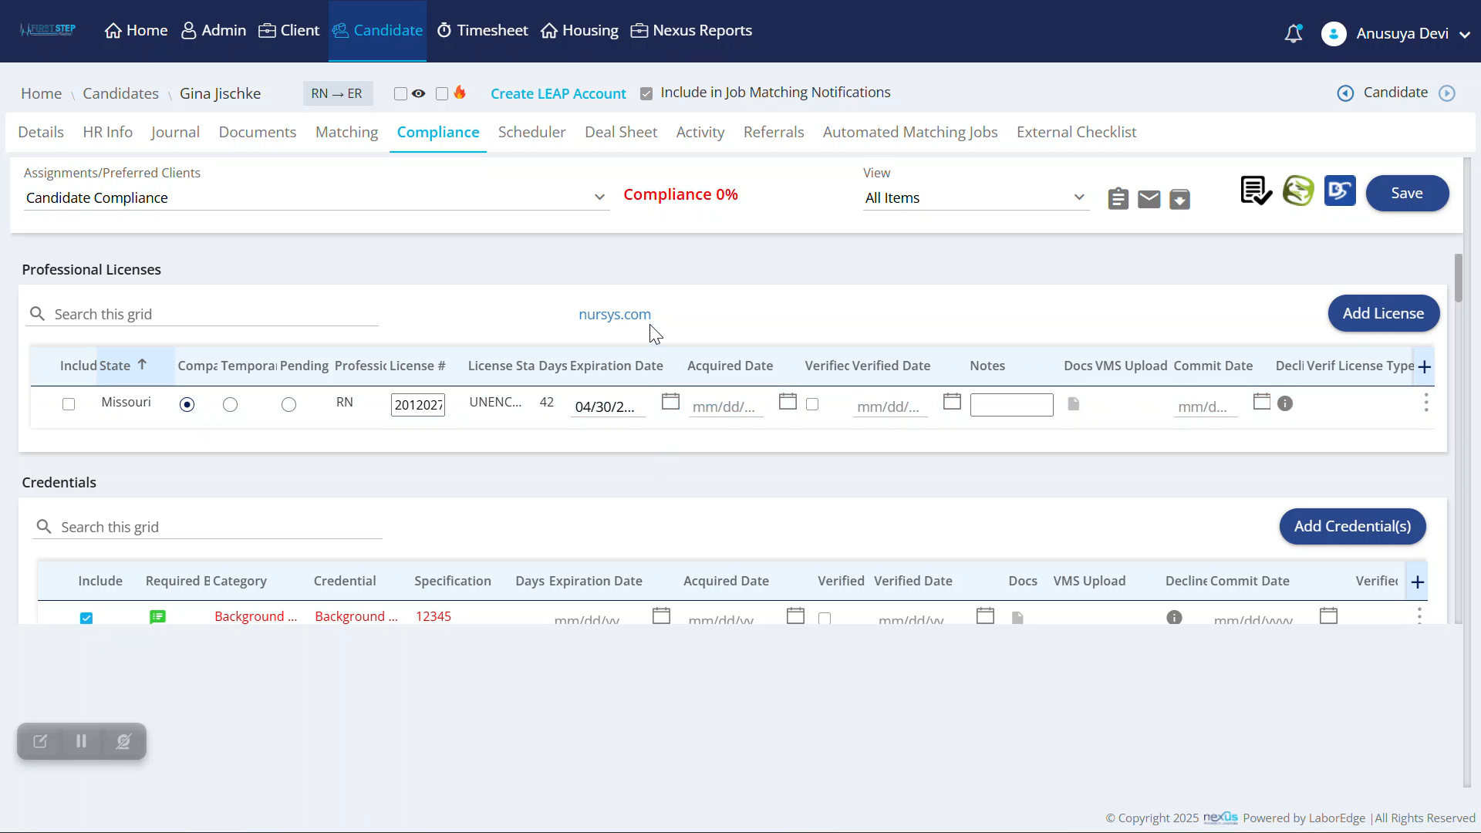
Notes:
Voiceover: For external verification, use this URL to access the Nursys portal’s QuickConfirm License Verification page where you have options to view or download the detailed report.

Slide 11
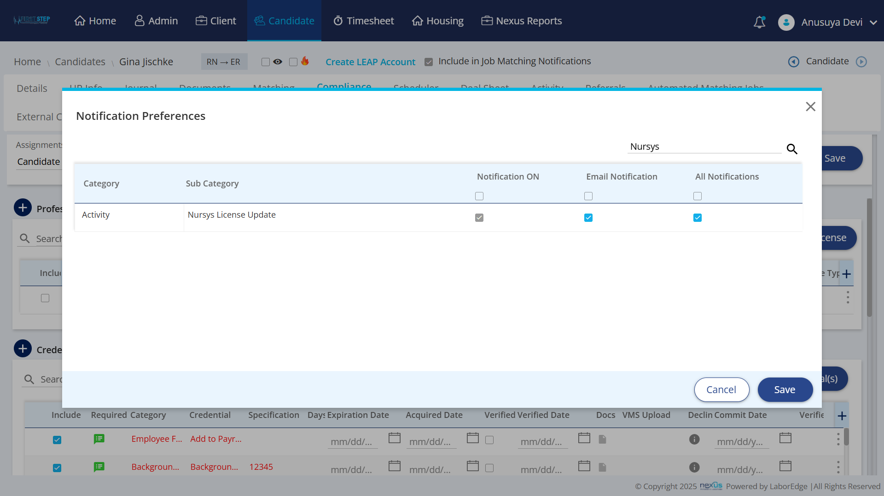
Notes:
Voiceover: The NexusATS scheduler regularly checks Nursys for license status changes, and sends automatic update notifications to users.

Slide 14







ONBOARDING
Notes:
Voiceover: Did you know that placing a nurse without verifying their license could lead to compliance issues, delays in onboarding, or even jeopardize patient safety?

Slide 15
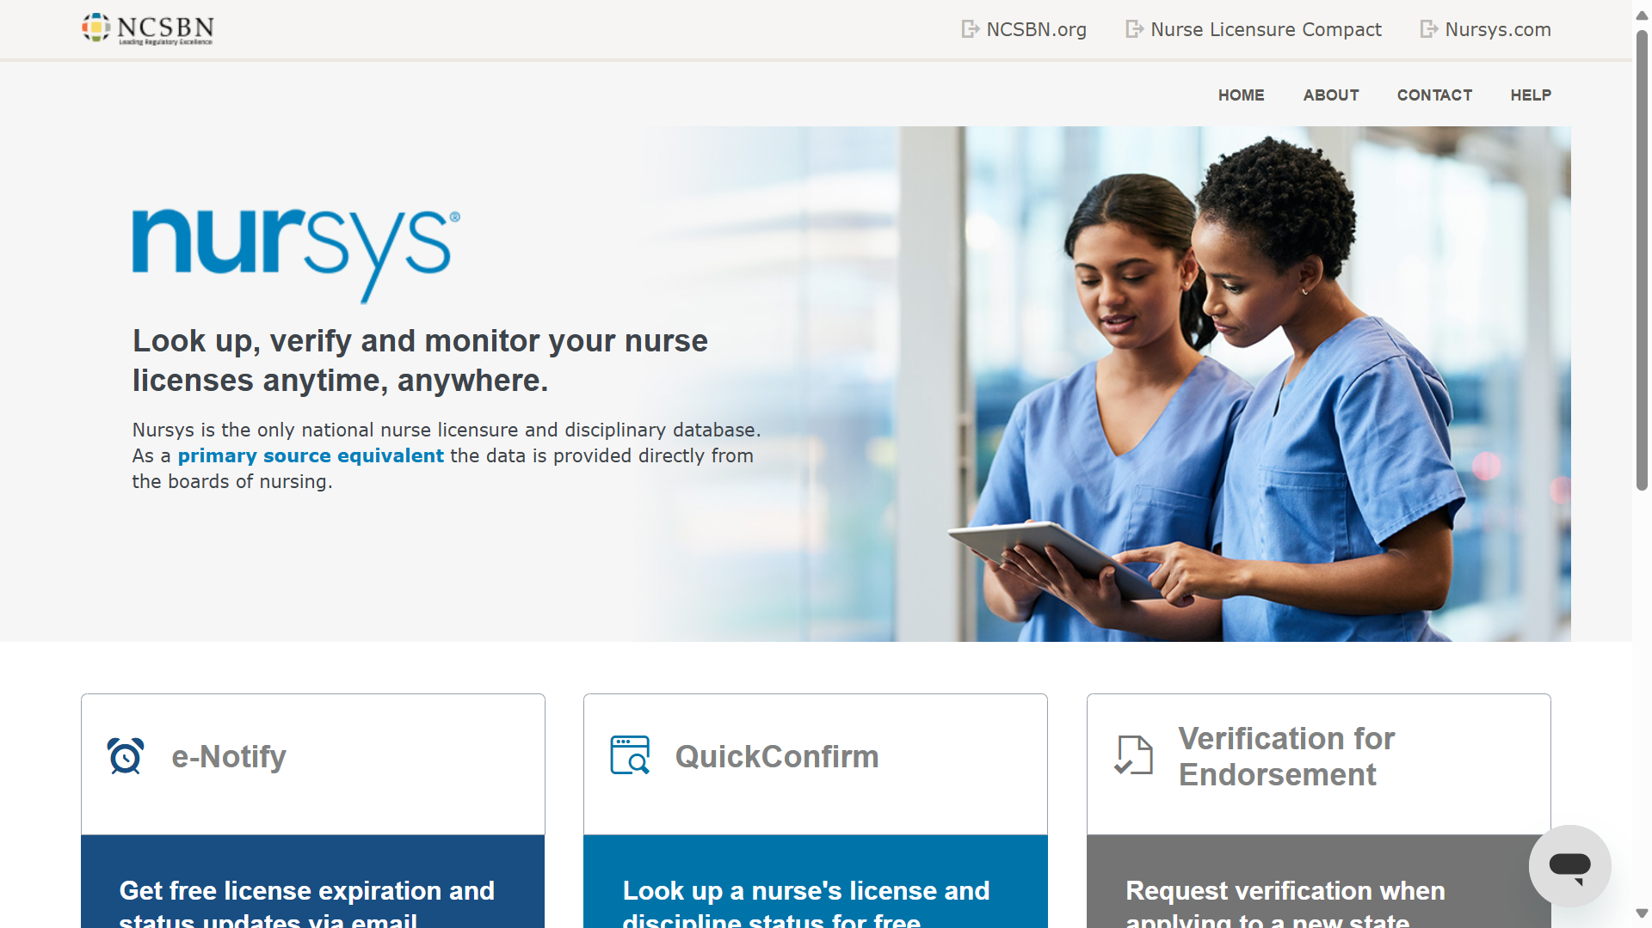
Notes:
Voiceover: That’s why Nursys delivers real-time, reliable license verification—making nurse endorsements and compliance checks seamless.

Slide 16






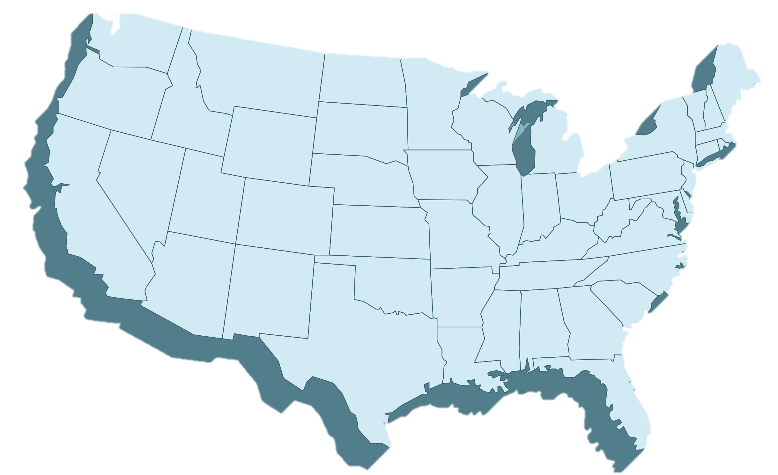


Nursys
Notes:
Voiceover: Nursys is the central database that connects state boards of nursing, nurses, and employment agencies like us.
When a nurse’s license status changes, or if there’s a disciplinary action, the state board updates its records—these updates flow directly into Nursys.
We can then access Nursys to instantly verify license details and practice privileges, all in real time.

Slide 17






Nursys
Notes:
Voiceover: Nursys is the sole national database for nurse licensure, discipline, and practice privileges.
Nursys keeps these data current and secure—as they are reviewed by State Boards of Nursing before being updated.
NexusATS connects with Nursys to auto-pull the verified licensure data directly into your workflow.
The integration thus powers real-time compliance checks and alerts for expiring credentials.

Slide 18
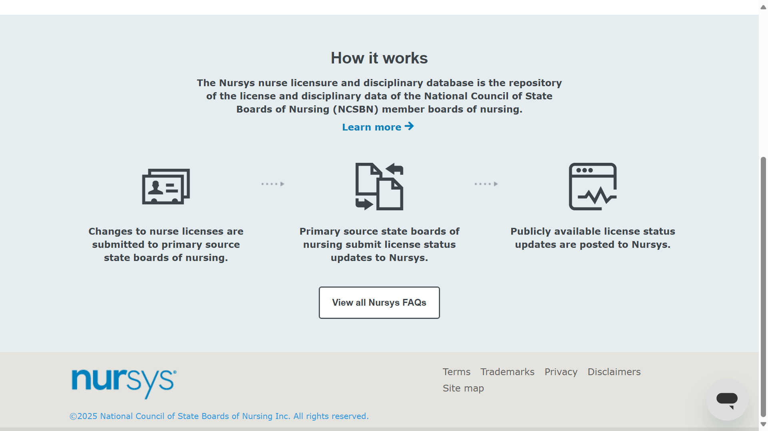



Notes:
Voiceover: Nursys streams real-time nurse license data straight from state boards.
As license updates happen, they’re submitted, verified, and published—all within Nursys in real-time.

